Slide 1
Structure Programming
ICT-1105
Information and Communication Technology
Lecture-10
Date:

Slide 2
Class contents has given in Google Classroom with code
nhauiw4

Slide 3
if-else Statement
The if statement by itself will execute a single statement, or a group of statements, when the expression following if evaluates to true.
By using else we execute another group of statements if the expression evaluates to false.

Slide 4
if-else Statement
Syntax : if (condition)
{
true statement;
}
else
{
false statement;
}
statement-x;

Slide 5
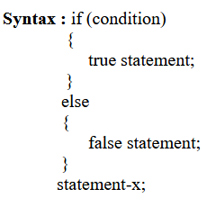
if-else Statement
If the condition is true , then the true statement and statement-x will be executed and if the condition is false, then the false statement and statement-x is executed.

Slide 6
if-else Statement
Or
If test expression is true, codes inside the body of if statement is executed and, codes inside the body of else statement is skipped.
If test expression is false, codes inside the body of else statement is executed and, codes inside the body of if statement is skipped..

Slide 7
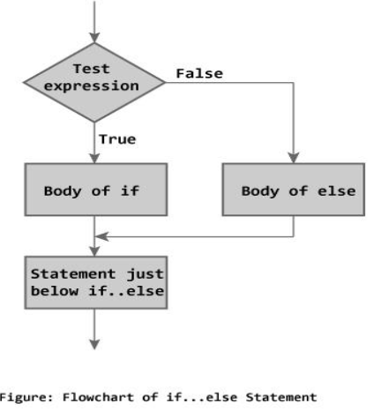
if-else Statement
Flowchart

Slide 8
if-else Statement
Programs:
Write a program to check whether the given number is even or odd.

Slide 9
if-else Statement
#include<stdio.h>
int main()
{
int n;
printf("Enter an integer\n");
scanf("%d",&n);
if ( n%2 == 0 )
printf("Even\n");
else
printf("Odd\n");
return 0;
}

Slide 10
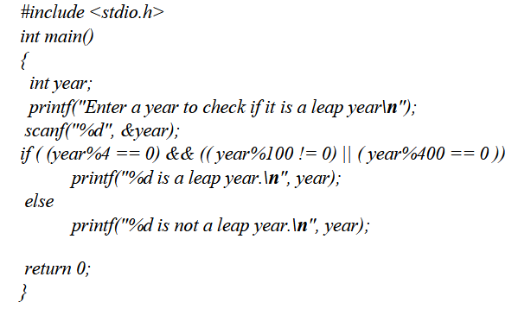
if-else Statement
Write a program to check whether a given year is leap year or not

Slide 11
Nested if-else statement
When a series of decisions are involved, we may have to use more than on if-else statement in nested form. If-else statements can also be nested inside another if block or else block or both.

Slide 12
Nested if-else statement
Syntax : if(condition-1)
{
if (condition-2)
{
statement-1;
}
else
{
statement-2;
}
}
else
{
statement-3;
}
statement-x;

Slide 13
Nested if-else statement
If the condition-1 is false, the statement-3 and statement-x will be executed. Otherwise it continues to perform the second test. If the condition-2 is true, the true statement-1 will be executed otherwise the statement-2 will be executed and then the control is transferred to the statement-x

Slide 14
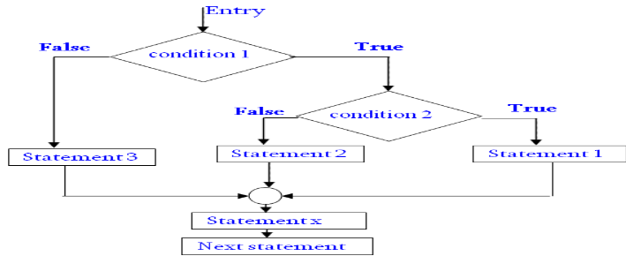
Nested if-else statement
Flowchart

Slide 15
Nested if-else statement
#include<stdio.h>
Int main()
{
int var1, var2;
printf("Input the value of var1:");
scanf("%d", &var1);
printf("Input the value of var2:");
scanf("%d",&var2);
if (var1 !=var2)
{
printf("var1 is not equal to var2");
//Below – if-else is nested inside another if block
if (var1 >var2)
{
printf("var1 is greater than var2");
}
else
{
printf("var2 is greater than var1");
}
}
else
{
printf("var1 is equal to var2");
}
…

Slide 16
Else if ladder
This sequence of if statements is the most general way of writing a multi−way decision. The expressions are evaluated in order; if an expression is true, the statement associated with it is executed, and this terminates the whole chain. As always, the code for each statement is either a single statement, or a group of them in braces.

Slide 17
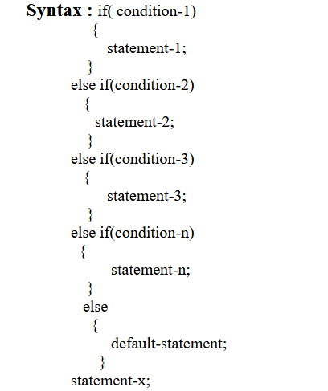
Else if ladder

Slide 18
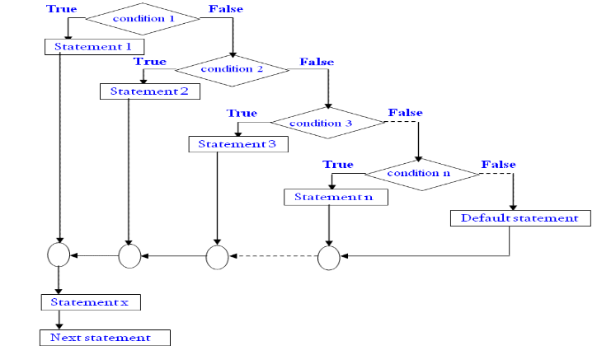
Else if ladder
Flowchart

Slide 19
Else if ladder
#include <stdio.h>
int main()
{
int m=40,n=20;
if (m>n)
{
printf("m is greater than n");
}
else if(m<n)
{
printf("m is less than n");
}
else
{
printf("m is equal to n");
}
}
Output:
m is greater than n

Slide 20
#include<stdio.h>
#include<conio.h>
void main()
{
int number=0;
clrscr();
printf("enter a number:");
scanf("%d",&number);
if(number==10)
{
printf("number is equals to 10");
}
else if(number==50)
{
printf("number is equal to 50");
}
else if(number==100)
{
printf("number is equal to 100");
}
else
{
printf("number is not equal to 10, 50 or 100");
}
getch();
}

Slide 21
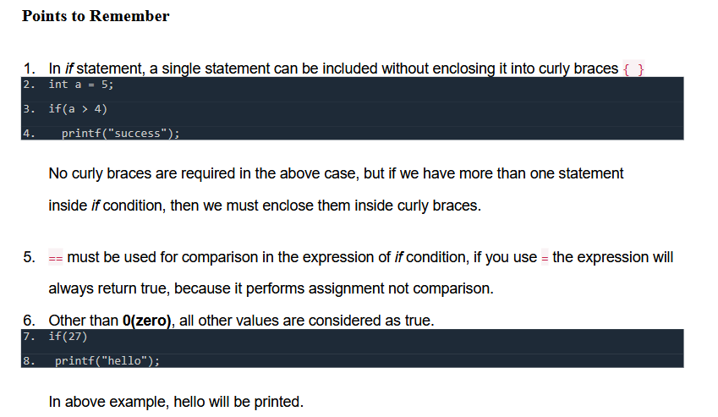

Slide 22
Switch statement
when there are several options and we have to choose only one option from the available ones, we can use switch statement. Depending on the selected option, a particular task can be performed. A task represents one or more statements.

Slide 23
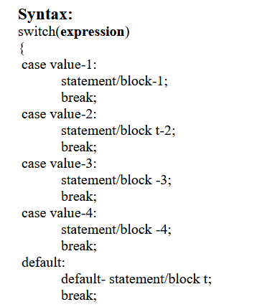
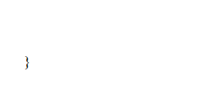
Switch statement

Slide 24
Switch statement
The expression following the keyword switch in any ‘C’ expression that must yield an integer value. It must be ab integer constants like 1,2,3 .
The keyword case is followed by an integer or a character constant, each constant in each must be different from all the other.

Slide 25
Switch statement
First the integer expression following the keyword switch is evaluated. The value it gives
is searched against the constant values that follow the case statements. When a match is found, the program executes the statements following the case. If no match is found with any of the case statements, then the statements following the default are executed.

Slide 26
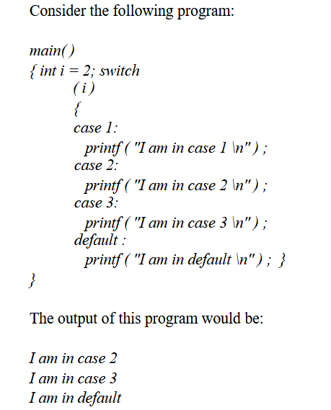
Switch statement

Slide 27
Switch statement
Here the program prints case 2 and 3 and the default case. If you want that only case 2 should get executed, it is up to you to get out of the switch then and there by using a break statement.

Slide 28
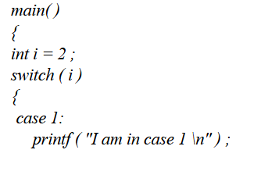
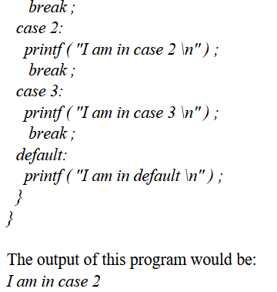
Switch statement

Slide 29
Switch statement
Write a program to enter a grade & check its corresponding remarks.

Slide 30
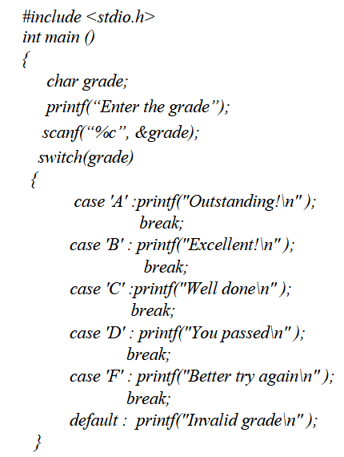
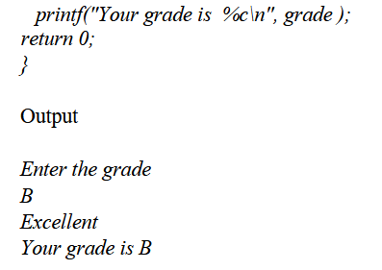
Switch statement

Slide 31
Rules for writing switch() statement.
1 : The expression in switch statement must be an integer value or a character constant.
2 : No real numbers are used in an expression.
3 : The default is optional and can be placed anywhere, but usually placed at end.
4 : The case keyword must terminate with colon ( : ).
5 : No two case constants are identical.
6 : The case labels must be constants.

Slide 32
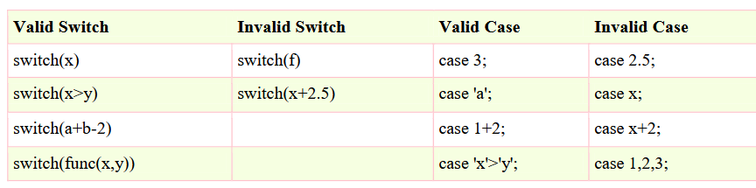
Rules for writing switch() statement.

Slide 33
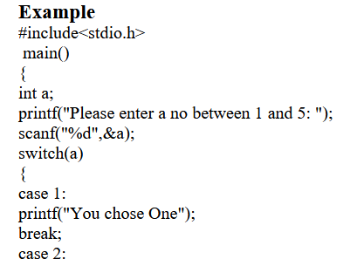
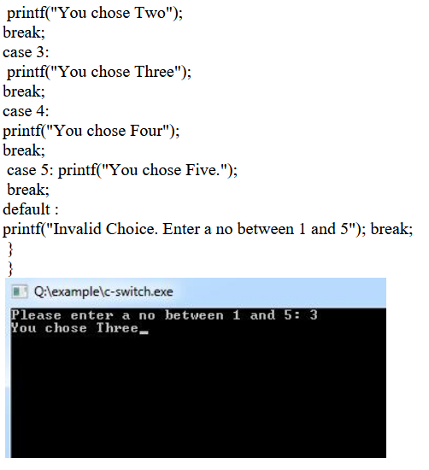

Slide 34
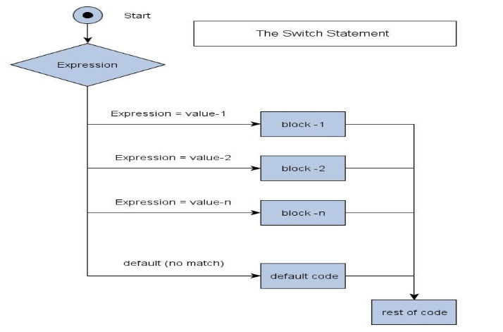
switch() statement.
Flowchart

Slide 35
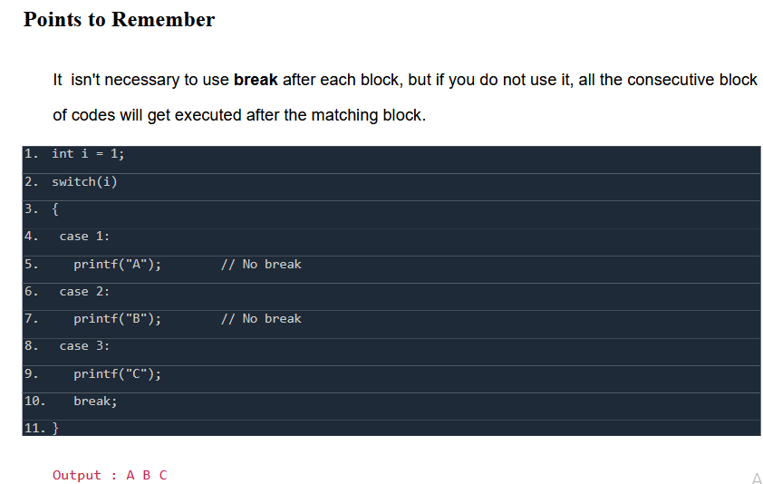
switch() statement.

Slide 36
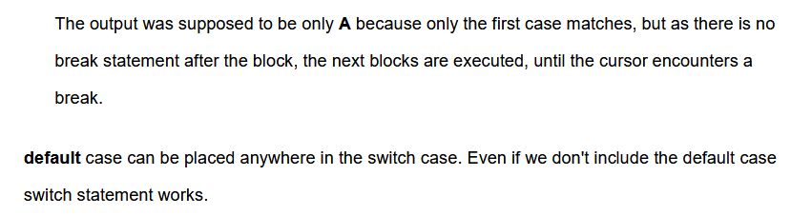
switch() statement.

Slide 37
Thank you….

